Slide 1
Softheon Enterprise
Friday, February 17th, 2017

Slide 2
Today’s Agenda
What is Softheon?
Softheon Entities
Enterprise REST API

Slide 3
Softheon :: Overview
Softheon is a Content Repository
Content is stored in Folders (a typed Folder is called an Entity)
Folders are stored in separate repositories called Drawers
Drawers can have different user permissions and allowed Entities

Slide 4
Softheon :: Overview :: Example

Slide 5
Entities :: Overview
A Folder is an abstract Entity
Entities are defined by Templates
A Template is a blueprint that gives meaning to the data stored in an Entity

Slide 6
Entities :: Metadata
Metadata is a collection of fields with values that describe the Entity.
Example: A Contact entity may have the following Metadata
Name
Birth Date
Phone Number
Address
Email

Slide 7
Entities :: Metadata :: Profiles
To better organize metadata, Entities can have 1 to many Profiles. Each Profile can have a collection of Fields.
Example: Contact entity organized into Profiles and Fields
Name Profile
First Name
Last Name
Dates Profile
Birth Date
Contact Profile
Address Line 1
Address Line 2
City
State
Zip
Phone Number
Email Address

Slide 8
Entities :: Metadata :: Field Types
A Field has a type and an index. The basic field types are:
String
Integer
Double
DateTime
Field values are stored as arrays of these 4 types on each Profile.

Slide 9
Entities :: Metadata :: Field Indexes
Each Profile can have a maximum of 32 string fields, 8 integer fields, 4 double fields, and 4 date fields. The index of the field specifies the location of its value within its type.
Example: Contact entity with Profile and Field Types and Indexes
Name Profile (1)
First Name (string:0)
Last Name (string:1)
Dates Profile (2)
Birth Date (DateTime:0)
Contact Profile (3)
Address Line 1 (string:0)
Address Line 2 (string:1)
City (string:2)
State (string:3)
Zip (integer:0)
Phone Number (string:4)
Email Address (string:5)

Slide 10
Entities :: Metadata :: Storage
Putting it all together, Fields map to arrays of values, arrays of values belong to a Profile, and arrays of Profiles belong to a Folder.

Slide 11
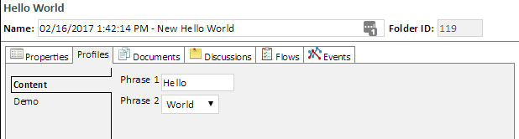
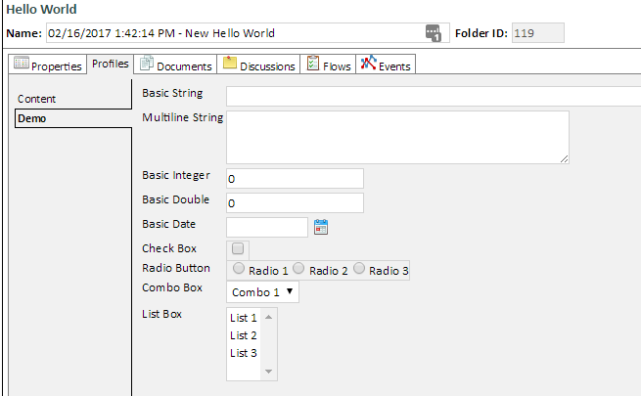
Entities :: Example
The following is an example of how an Entity may be presented.

Slide 12
Enterprise API
https://hack.softheon.io/api/enterprise
The Enterprise API allows for the manipulation of Templates and Entities

Slide 13
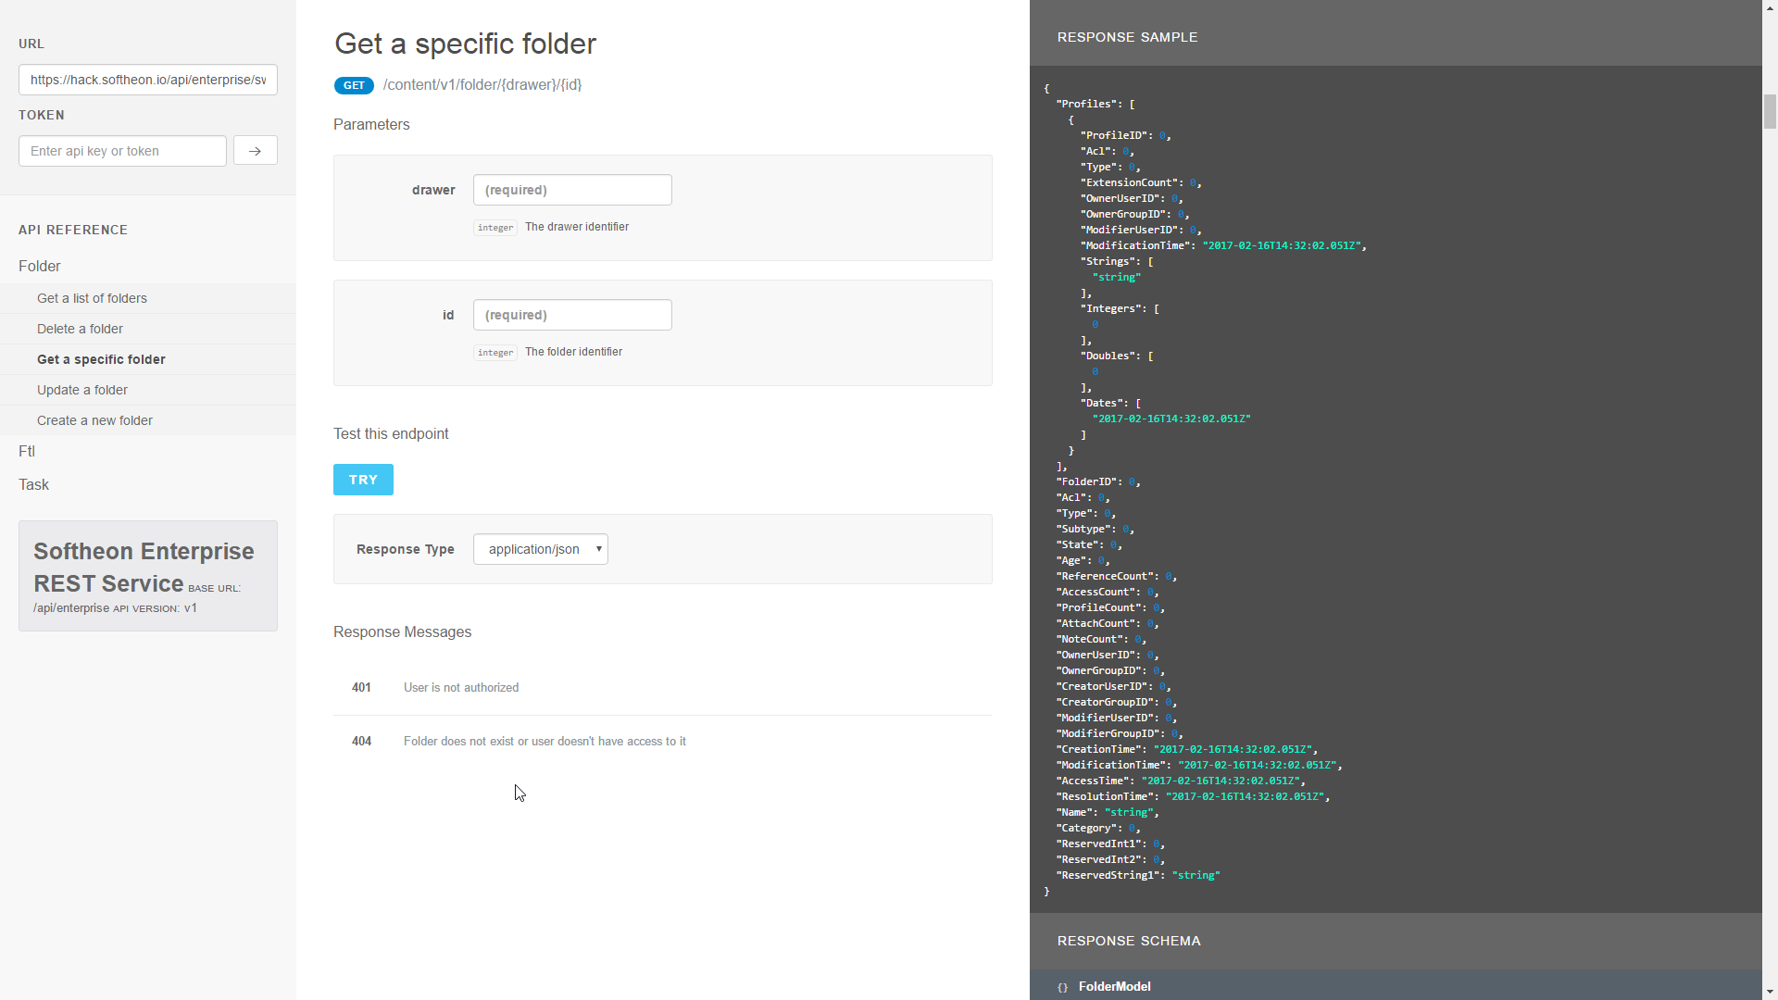
Enterprise API :: Documentation
https://hack.softheon.io/api/enterprise/documentation
The Enterprise API has a documentation site that details all available requests complete with their parameters, response codes, and response objects. It also allows invocation of the API directly

Slide 14
Enterprise API :: Templates
https://hack.softheon.io/api/enterprise/template/v1/ftl
The template endpoint allows the following functions
Get One (by type)
Get One (by ID)
Insert
Update (by type)
Update (by ID)
Delete (by type)
Delete (by ID)

Slide 15
Enterprise API :: Folders
https://hack.softheon.io/api/enterprise/content/v1/folder
The template endpoint allows the following functions
Get List
Get One (by ID)
Insert
Update (by ID)
Delete (by ID)

Slide 16
Enterprise API :: Code Samples
The Softheon GitHub has two sample projects that show how to invoke all of the template and folder endpoints.
C# Sample: https://github.com/Softheon/EnterpriseApiClient-CSharp
JavaScript Sample: https://github.com/Softheon/EnterpriseApiClient-Javascript

